Slide 1
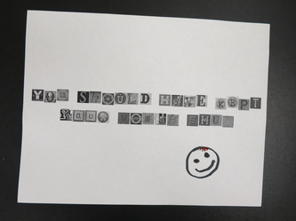
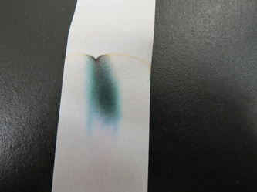
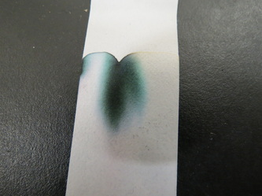
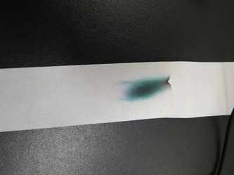
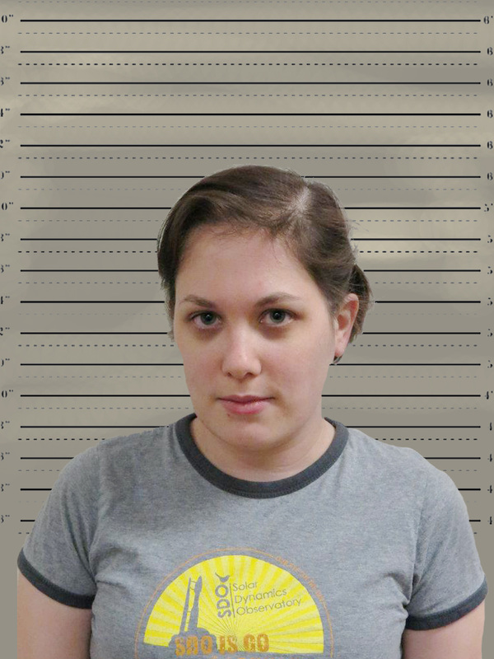
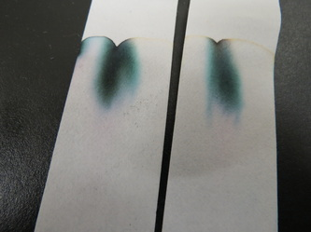
The Note Analysis
THE RANSOM NOTE!!
DRY- ERASE MARKER
MARKS-A-LOT
CRAYOLA MARKER #1
CRAYOLA MARKER #2
LIQUI-MARK
PERFECT MATCH !!
Suspect !!

