Slide 1
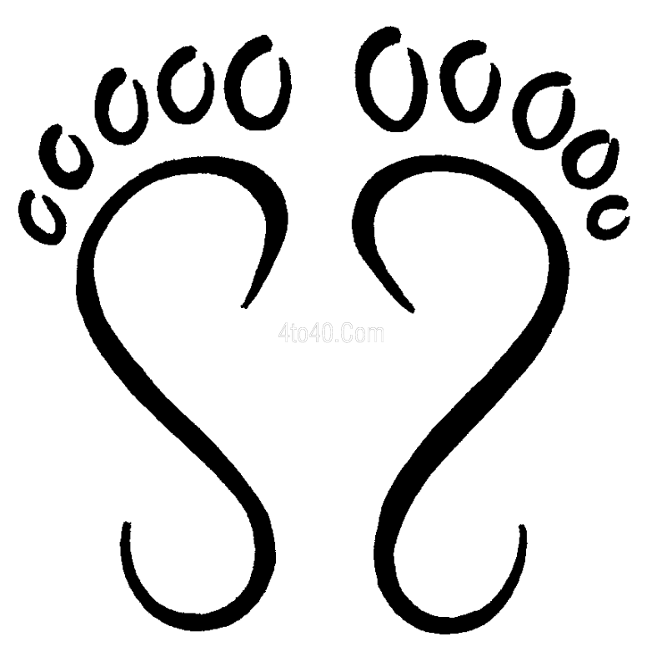
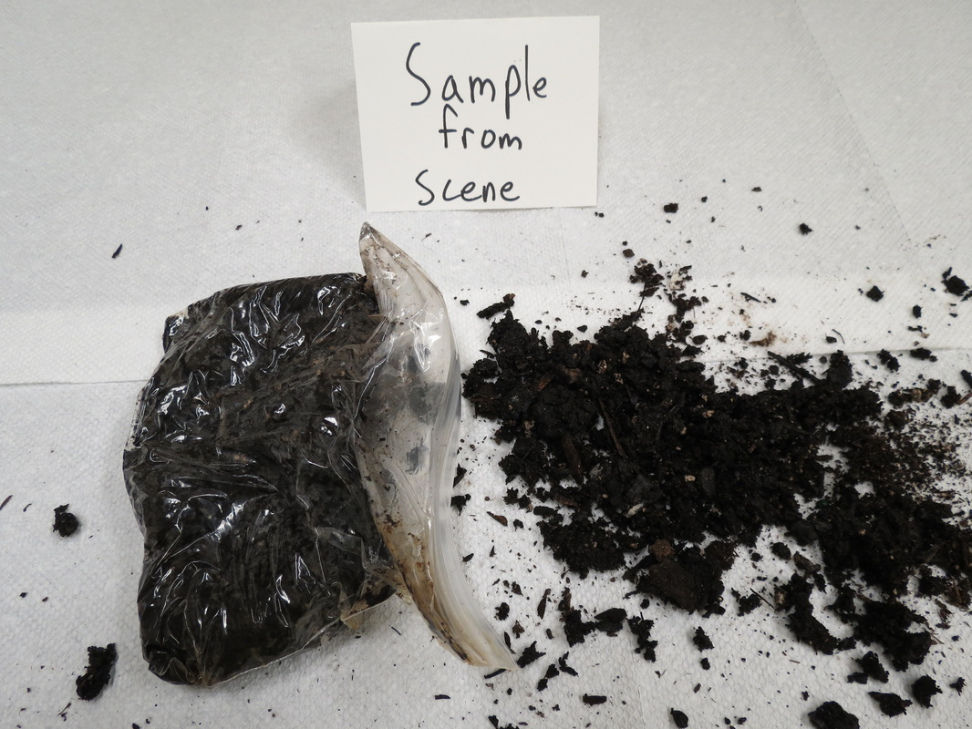
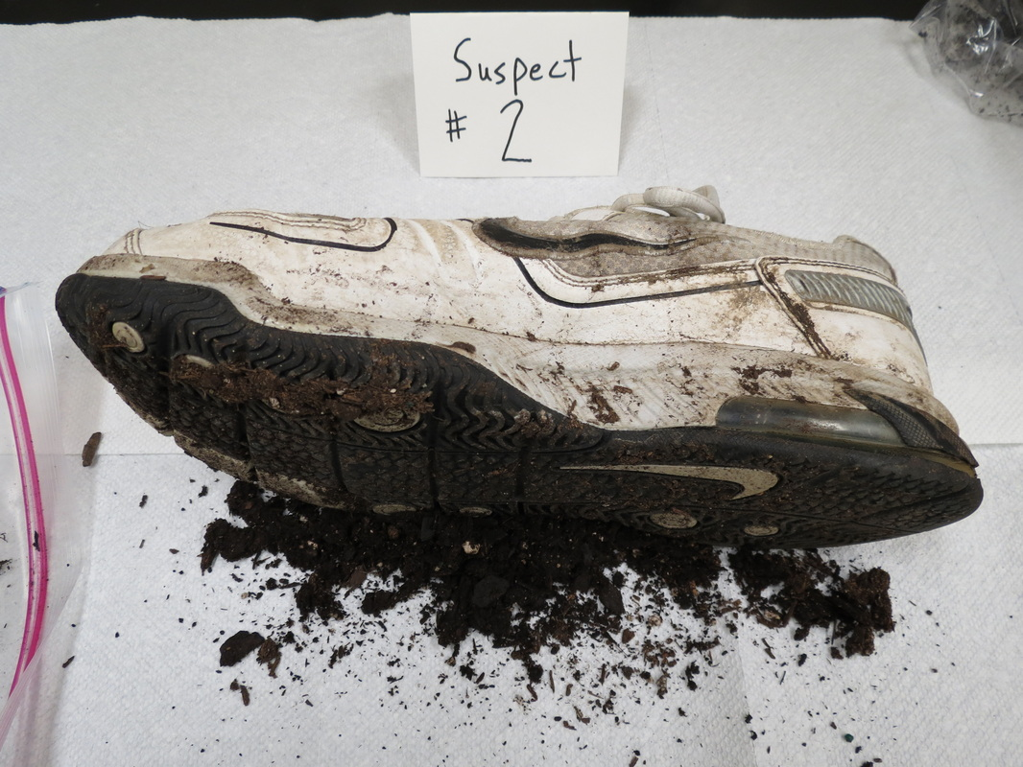
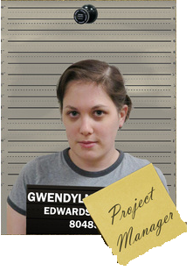
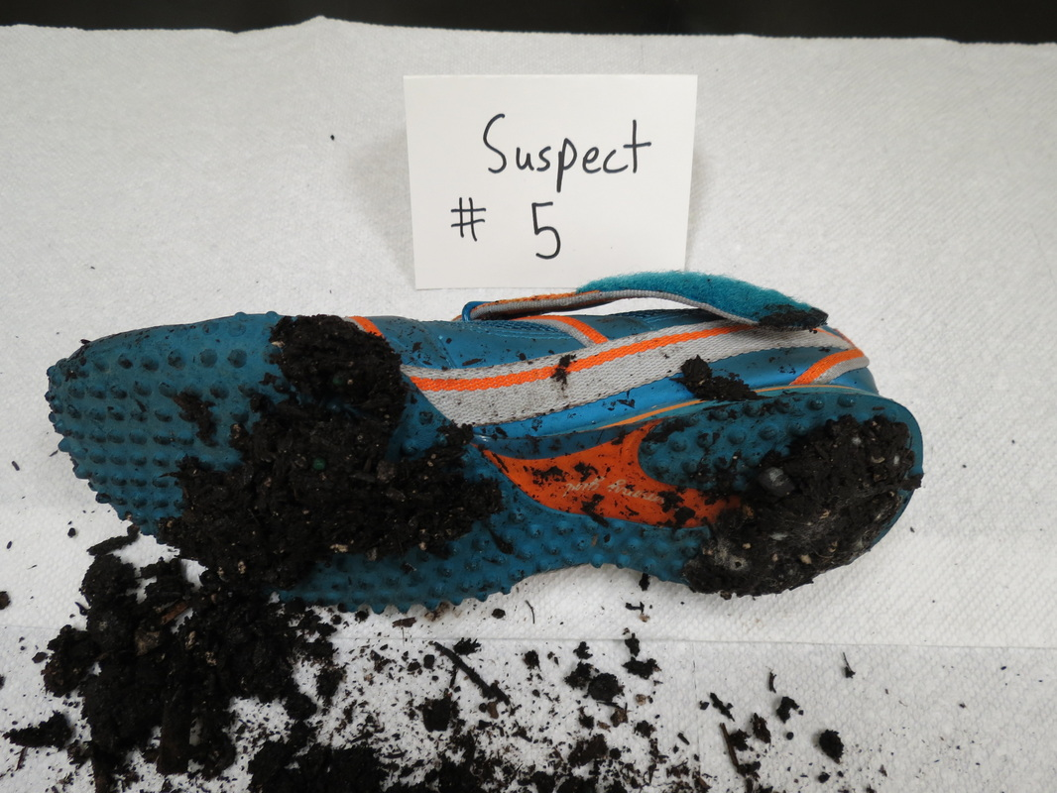
Soil Analysis
The soil found at the crime scene matched closest to the soil found on Charles Key`s and Gwendolyn Dolittle`s shoes.
Crime scene soil
pH: 5.78
Conductivity: 3044
Charles Keys
Suspect 2
pH: 5.38
Conductivity: 3026
Suspect 5
Gwendolyn Dolittle
pH: 5.54
Conductivity: 3078

